Slide 1

Random Forest & XG Boost
On Amazon SageMaker &
Lambda Functions
By Sriramya Kannepalli

Slide 2
Let’s get started -
Decision Trees, Random Forest and XG Boost
Overview of Amazon S3, SageMaker and Lambda Functions
Implementing XG Boost on Amazon SageMaker
Deploying endpoints in Amazon Lambda Functions

Slide 3
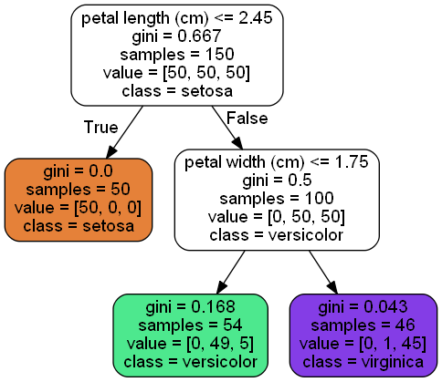
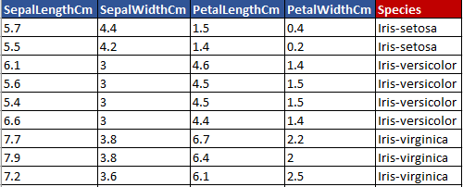
Decision Trees
A decision tree is built top-down from a root node and involves partitioning the data into subsets that contain instances with similar values (homogenous).
Decision tree builds regression or classification models in the form of a tree structure.
Root Node
Predictors
Target
Branch
Decision Node
Leaf Node

Slide 4
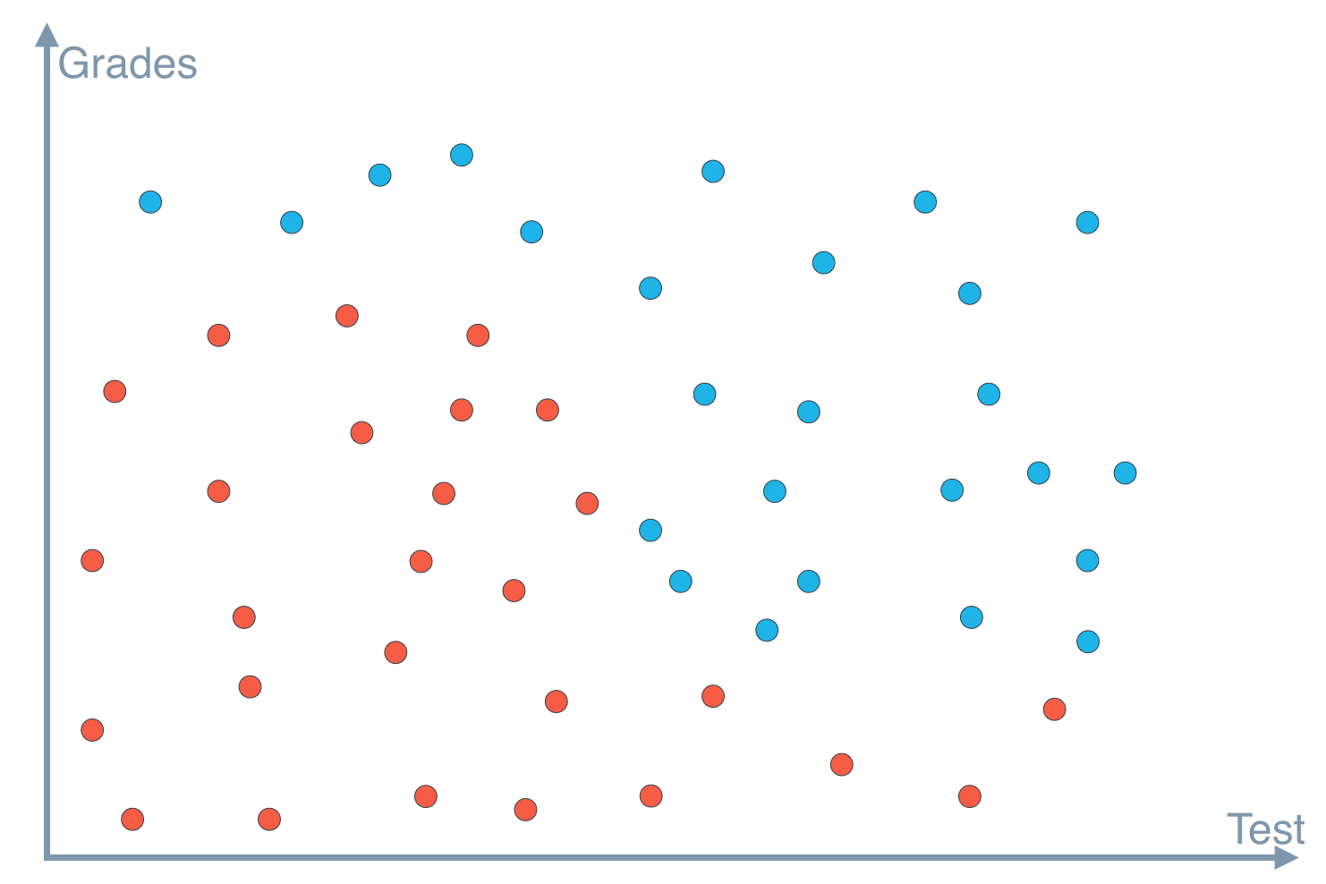
The first best split divides data into two heterogenous groups which are homogenous in themselves.
Decision Tree
Decision tree Learning Algorithm
Choose an attribute from your dataset.
Calculate the significance of attribute in splitting the data.
Split data based on the value of the best attribute.
Go to step 1.
5
Data : Student Admissions

Slide 5
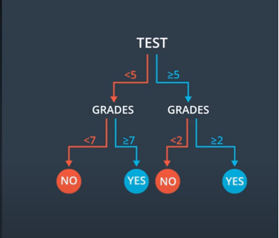
Decision Tree : Student Admissions
Decision tree Learning Algorithm
Choose an attribute from your dataset.
Calculate the significance of attribute in splitting the data.
Split data based on the value of the best attribute.
Go to step 1.
7
2
5

Slide 6
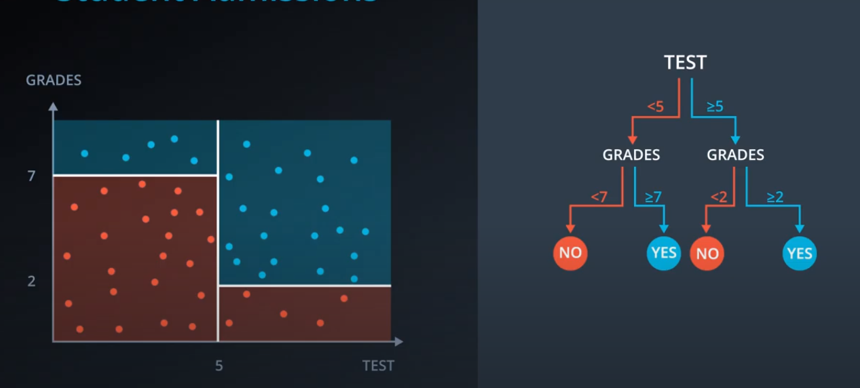
Decision Tree : Student Admissions
Decision tree Learning Algorithm
Choose an attribute from your dataset.
Calculate the significance of attribute in splitting the data.
Split data based on the value of the best attribute.
Go to step 1.

Slide 7


Entropy
Measure of randomness or uncertainty.
1 No
9 Yes
4 No
6 Yes
Entropy = -p(A)log(p(A)) - p(B)log(p(B))
Entropy is Low
Entropy is high
Lower the Entropy, the less uniform the distribution, the purer the node.
0 No
10 Yes
5 No
5 Yes
Entropy = 0
Entropy = 1

Slide 8
Information Gain
Information Gain is the information that can increase the level of certainty after splitting.
Information Gain = (Entropy before Split) – (weighted entropy after split)
Entropy before Split
E = 0.940
Weighted Entropy
Information Gain
Cholesterol
Normal
High
Weighted Entropy after split
E = 0.82
E = 1
Weighted Entropy after split

Slide 9
Choose
Choose an attribute from your dataset.
Calculate
Calculate the significance of attribute in splitting the data.
Split
Split data based on the value of the best attribute.
Go
Go to step 1.
Decision tree Learning Algorithm

Slide 10

Fable of blind men and elephant

Slide 11
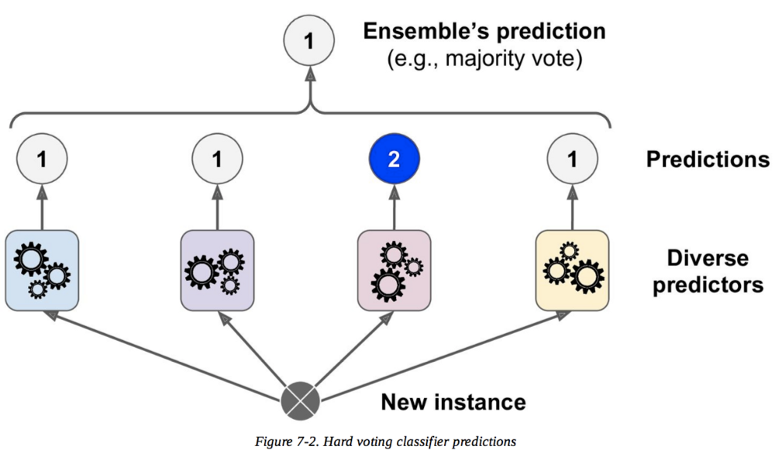
Tree Ensemble Methods
Easy to understand and visualize.
Non-parametric and doesn’t require to follow normal distribution.
Can handle mixed data types.
Multi-collinearity of features does not affect the accuracy and prediction performance of the model.
Robust against overfitting.
Relatively robust against outliers and noise.
Inputs do not need to be scaled.
Computationally relatively inexpensive.

Slide 12
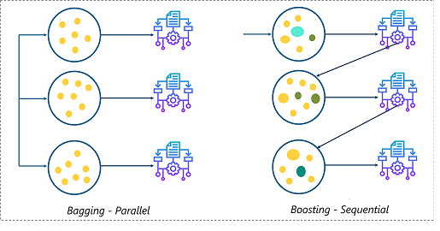
Bagging and Boosting

Slide 13

Random Forest
A Random Forest is an ensemble of Decision Trees, generally trained via bagging method( or sometimes the pasting method) typically max-samples set to the size of the training set.
Bagging – (short for Bootstrap aggregating) is drawing samples from the data set with replacement.
Random forests achieve a reduction in overfitting by combining many weak learners that underfit because they only utilize a subset of all training samples.

Slide 14
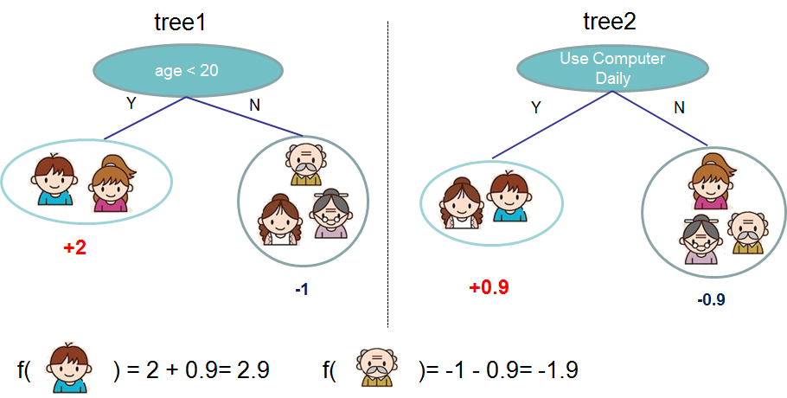
XG Boost
(eXtreme Gradient Boosting)
Gradient Boosting trees use regression trees (or CART) in a sequential learning process as weak learners.
These regression trees are similar to decision trees, however, they use a continuous score assigned to each leaf (i.e. the last node once the tree has finished growing) which is summed up and provides the final prediction.
Sequential tree growing.
Minimizing loss function using gradient descent .
Parallel processing to increase speed.
Regularization parameter.
Source: Chen & Guestrin (2016)
Boosted Group of decision trees
New trees made to correct the errors of previous trees
Uses gradient descent to minimize loss as new trees are added.

Slide 15
XG Boost: Hyperparameters
There are lot of hyperparameters, few of them are :
Subsample
Prevents Overfitting
Eta
Step size shrinkage, prevents overfitting.
Gamma
Minimum loss reduction to create a partition, larger = more conservative
Alpha
L1 regularization term; larger = more conservative
Lambda
L2 regularization term; larger = more conservative

Slide 16
SageMaker ML Workflow
Fetch , clean and prepare data
Train and evaluate a model
Deploy model, evaluate results in production

Slide 17
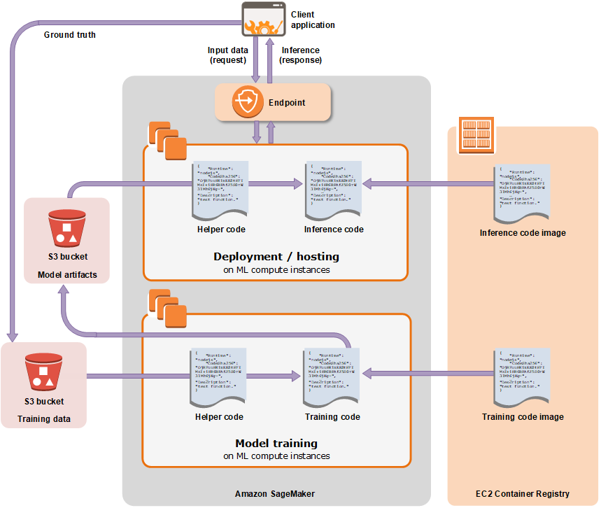
SageMaker : Training & Development

Slide 18
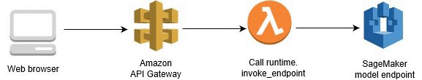
Amazon API Gateway and AWS Lambda

Slide 19

Thank You

Slide 20
End Notes
Adapted from “Random Forest Simple Explanation,” by Will Koehrsen, 2017, retrieved from https://medium.com/@williamkoehrsen/random-forest-simple-explanation-377895a60d2d

